Slide 1



Machine Learning Project Group No :- 4 Credit Score Prediction
SUBMITTED BY :-
Prem Chavan, Rupal Nikum, Atharva Shastri, Prakhar Choudhary, Ashish Bikkad, Chaitanya Thipse

Slide 2

About the Data:-
1) The dataset consists of all the basic bank details of the customers, and the dataset has categorical and numerical variables.
2) It has missing values and more anomalies. It consists of the customer’s bank and professional details over the years so we can explore more of it.
3) You have given the two data sets namely Train and Test datasets.
4) Kindly use the TRAIN dataset to build and test the model. And use the Test dataset to submit your results.

Slide 3
Industry Review :- Current practices
Credit cards are a ubiquitous part of modern society, with millions of people around the world using them for everyday transactions.
Credit cards are a type of payment card that allows consumers to borrow money from a financial institution in order to make purchases.
They offer many benefits, such as convenience, rewards, and fraud protection, but they also come with risks, such as high interest rates and fees.
One of the biggest challenges facing the credit card industry today is fraud. Credit card fraud is a serious problem, with criminals using a variety of tactics to steal card information and make unauthorized purchases.

Slide 4
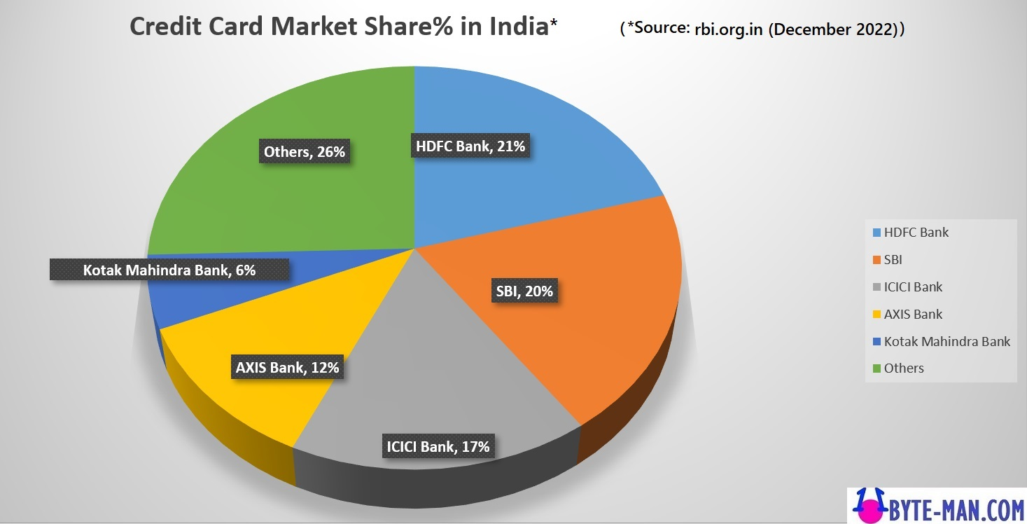
Literature Survey :- past/History and undergoing research
The first true credit card, which could be used at multiple merchants, was the Diners Club card,
introduced in 1950.
The Diners Club card was initially marketed to businessmen who needed to travel frequently and wanted
a convenient way to pay for expenses.
The card was accepted at a variety of restaurants, hotels, and other merchants, and customers were
billed for their charges each month.
4) The companies who manufacture the credit cards are A] American Express B] Discovery C] Mastercard,
D] Visa
.

Slide 5
Attributes:-
1) ID - Represents a unique identification of an entry.
2) CUSTOMER ID - This represents the unique identification of a person.
3) MONTH - Represents the month of the year.
4) NAME - Represents the name of a person.
5) AGE - Represents the age of the person.
6) SSN - Represents the social security number of the person.
7) OCCUPATION - Represents the occupation of the person.
8) ANNUAL INCOME - Represents the yearly income of the person.
9) MONTHLY IN-HAND SALARY - Represents the monthly base salary of a person.
10) NUM BANK ACCOUNTS - This represents the number of bank accounts a person holds.
11) NUM CREDIT CARD - This represents the number of other credit cards held by the person.
12) INTEREST Rate - This represents the interest rate on a credit card.
13) NUM OF LOAN - Represents the number of loans taken from the bank.
14) TYPE OF LOAN - Represents the type of loan taken by the person.
15) DELAY FROM DUE DATE - Represents the average number of days delayed from the payment date.
16) NUM OF DELAYED PAYMENT - Represents the average number of payments delayed by a person.

Slide 6
Attributes:-
17) CHANGED CREDIT LIMIT - This represents the percentage change in
the credit card limit.
18) NUM CREDIT INQUIRIES - Represents the number of credit card inquiries.
19) CREDIT MIX - This represents the classification of the mix of credits.
20) OUTSTANDING DEBT - This represents the remaining debt to be paid(in USD).
21) CREDIT UTILIZATION RATIO - This represents the utilization ratio of credit cards.
22) CREDIT HISTORY AGE - This represents the age of the credit history of the person.
23) PAYMENT OF MIN AMOUNT - Represents whether only the minimum amount was
paid by the person.
24) TOTAL EMI PER MONTH - Represents the monthly EMI payments(in USD).
AMOUNT INVESTED MONTHLY - Represents the monthly amount invested by
the customer(in USD)
26) PAYMENT BEHAVIOUR - Represents the payment behavior of the customer (in USD)
27) MONTHLY BALANCE - Represents the monthly amount of the customer (in USD).

Slide 7
Problem Statement :-
We are working as a data scientist in a global finance company.
Over the years, the company has collected basic bank details and gathered a lot of credit-related information.
3) The management wants to build an intelligent system to segregate
the people into credit score brackets to reduce manual efforts.

Slide 8
Objective:-
The objective of this project is to explore the data to identify the pattern that causes the person to have a good or bad or standard type credit score and build a machine learning model that should be able to predict or classify the credit score type.

Slide 9

Business Importance:-
Increased sales:- By accepting credit cards, businesses can increase their sales by providing customers with a convenient way to pay for their purchases. which can lead to increased revenue for the business.
Improved cash flow:- Credit card payments are typically processed faster than other forms of payment, such as checks, which can improve a business's cash flow.
Fraud protection:- Credit card issuers typically offer fraud protection to their cardholders. If a fraudulent transaction occurs, the credit card issuer will typically cover the cost of the transaction, which can help to reduce losses for the business.

Slide 10
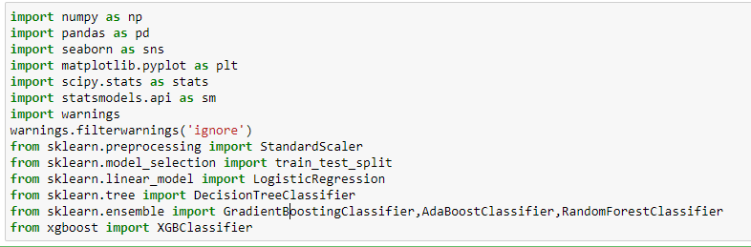
Step 1:Understand the business problem
To identify the pattern that causes the person to have a good or bad or standard type credit score and build a machine learning model that should be able to predict or classify the credit score type.
Step 2: Import all the libraries and set up all the requirements that you will be needed

Slide 11
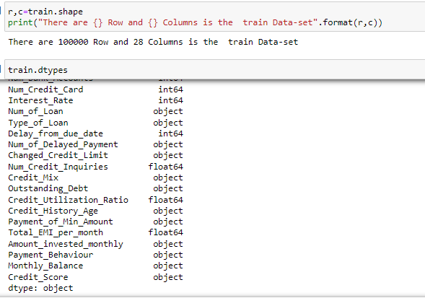
Step 3: Read the train and test data sets, and check for the datatype

Slide 12
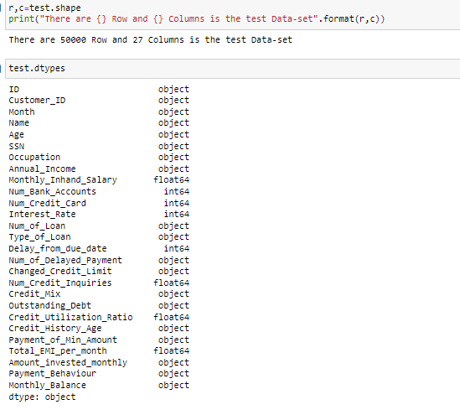

Slide 13
Step 4: Fix the problem that the features have been wrongly identified. Note: One way to clean the training and testing data is to combine both train and test datasets. Then do the cleaning. i) Clean the anomalies in the categorical variables. A few anomalies have been mentioned here.
Occupation - ___
SSN - #F%$D@*&8
Payment Behaviour - !@9#%8 Replace the above anomalies by replacing them with the mode of each customer. ii) Clean the anomalies for numerical variables. Ex:
Age has above 8000 values therefore replace the values that are above 100 or 85 with median values. Note: I encourage you to replace the abnormal values with customer ID-wise median replacement for the customers who have above and below abnormal values. (customer-wise median means the median value for each customer. Example: customer aaa Annual Income has anomaly value in one row so replace that with customer aaa Annual Income median value. )

Slide 14
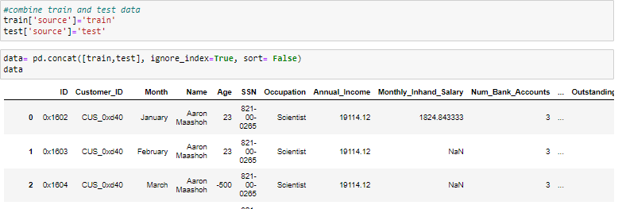
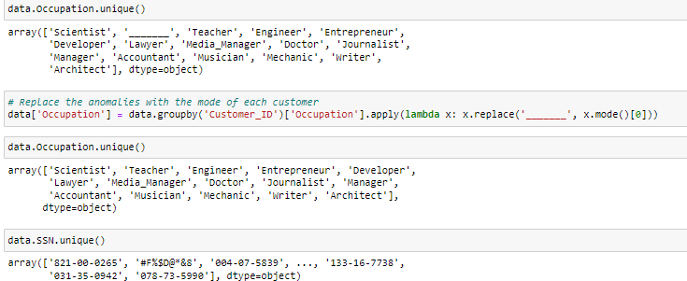

Slide 15
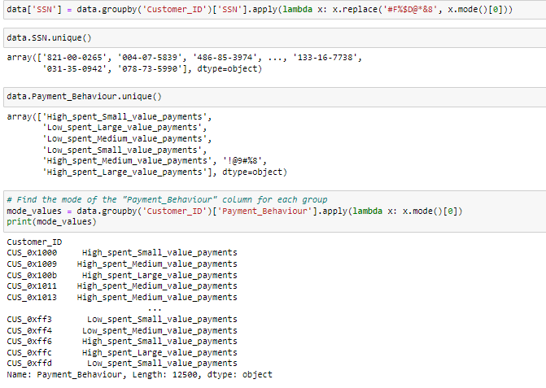

Slide 16
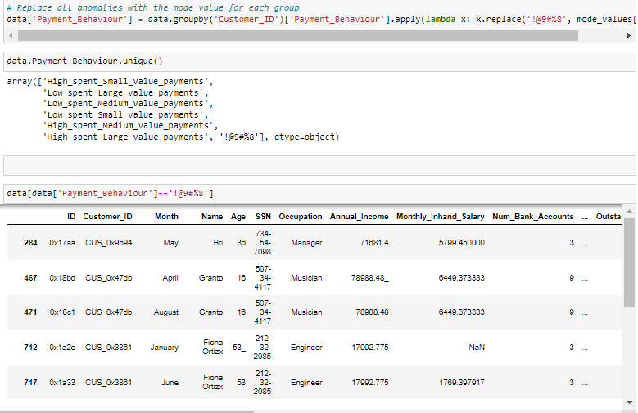
In payment_Behaviour variable even after replacing anomolies with mode it is still showing the anomolies in more then 1300 rows. as they have unique customer id.hence to treat them we will replace them with null values.

Slide 17
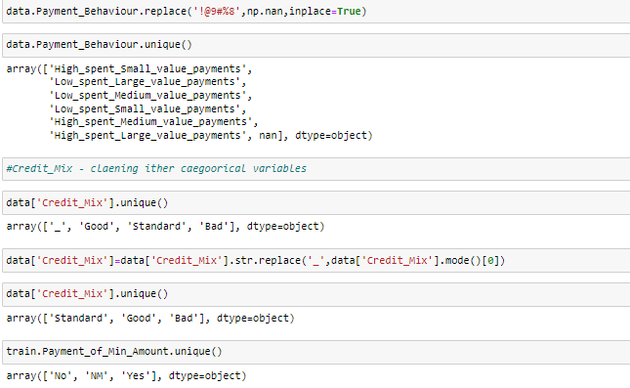

Slide 18
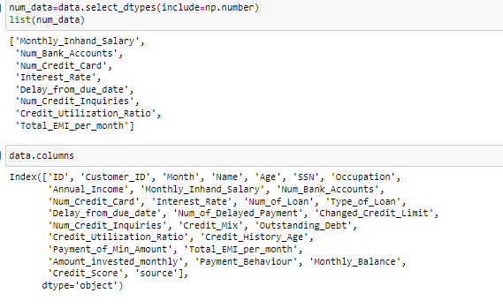
ii) Clean the anomalies for numerical variables. Ex: 1. Age has above 8000 values therefore replace the values that are above 100 or 85 with median values. Note: I encourage you to replace the abnormal values with customer ID-wise median replacement for the customers who have above and below abnormal values. (customer-wise median means the median value for each customer. Example: customer aaa Annual Income has anomaly value in one row so replace that with customer Annual Income median value. )
There arre certain vairables which are numeric like "Age",'Annual_Income','Num_of_Loan', Amount_invested_monthly,'Monthly_Balance',Delay_from_due_date,'Num_of_Delayed_Payment','Changed_Credit_Limit', this all are the numerical variables but due to presence of string it has misleaded data types.

Slide 19
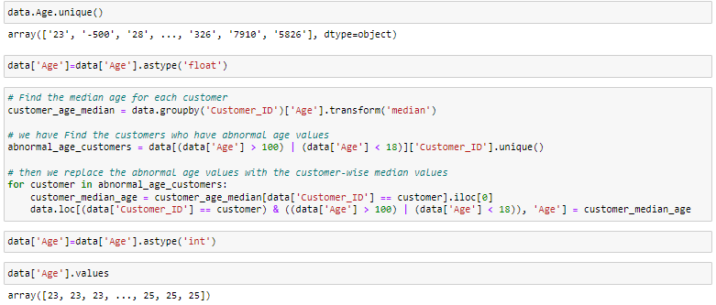
Age
Here we have replace the abnormal values with median by each customer Id

Slide 20



Annual Income
There are no negative values in Anuual_Income Hence there is no need to treat them
Amount_invested_monthly
There are no negative values
Monthly_Balance
There are no negative values ​

Slide 21

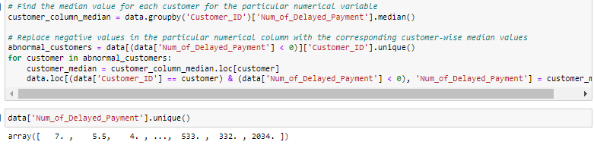
Num_of_Delayed_Payment
As the column has Nan value which is considered as Float-point and we cannot convert the variable type into Int hence we replaced that nan with certain int value and then the column also contain string like ".1" we need to addresse it and then change the datatype

Slide 22

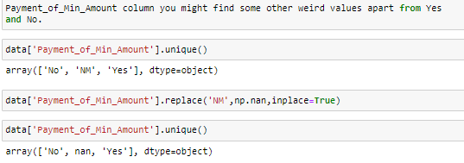
Step 6: Convert the Credit_History_Age datatype variable into float data types by taking only year and month. Example. 22 years and 1 month → 22.1. And the Payment_of_Min_Amount column you might find some other weird values apart from Yes and No. And If you have combined the train and test datasets, then change the month's names into its number

Slide 23
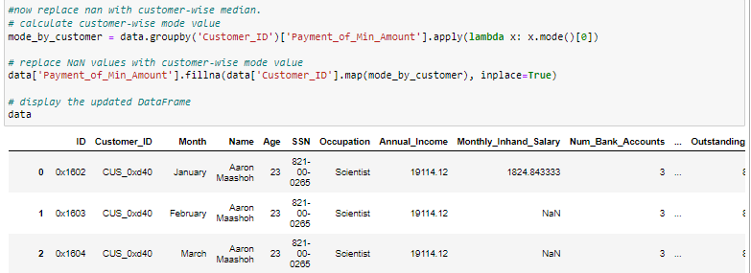
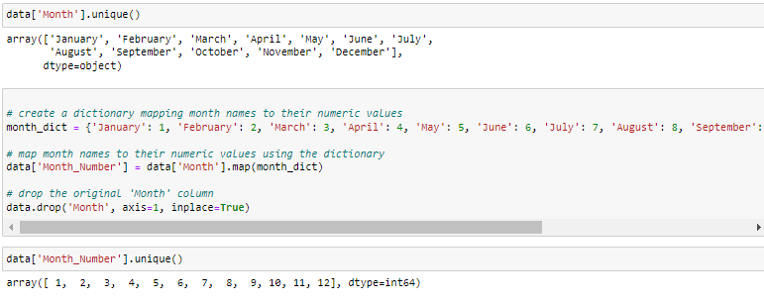

Slide 24
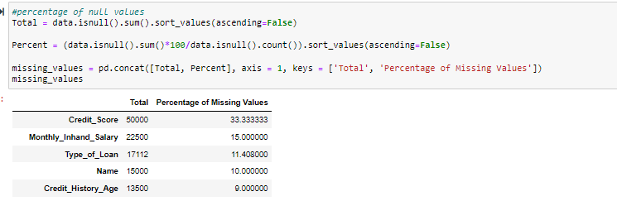
Step 7: Find out the missing values in the data frame and handle them in the best way possible. One way of solving this is by imputing the missing values with a customer-wise median.
Monthly_Inhand_Salary Type_of_Loan Name Credit_History_Age Amount_invested_monthly Monthly_Balance Changed_Credit_Limit Num_Credit_Inquiries Payment_Behaviour all this variables contain null values

Slide 25

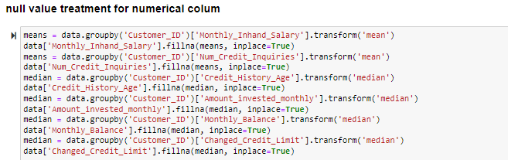
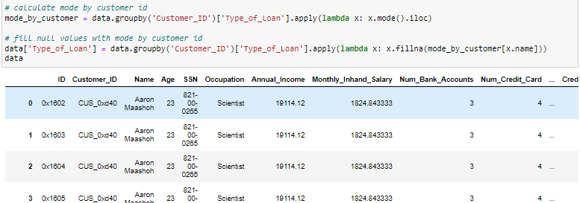
Null value treatment for categorical columns

Slide 26
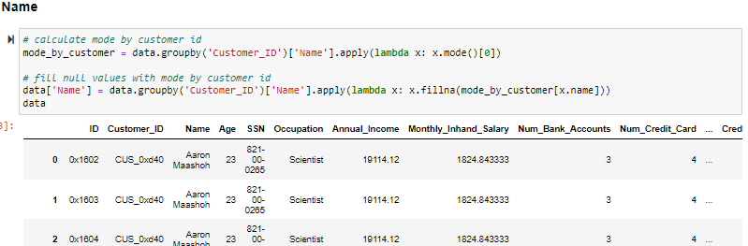
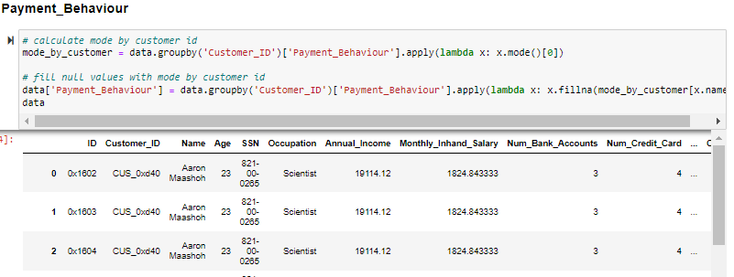

Slide 27

Step 8: Perform Univariate, Bivariate, and Multivariate analyses to find the factors that affect the Target variables.
Univariate Analysis for numerical variable

Slide 28
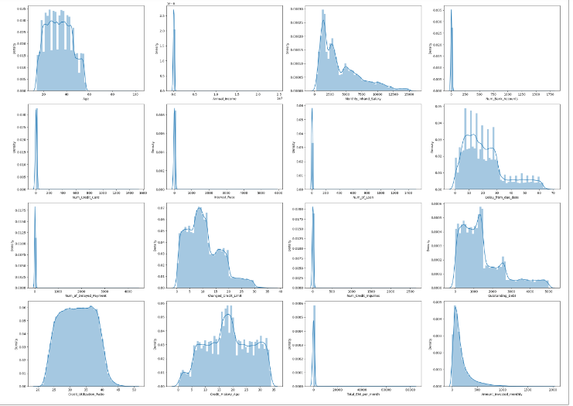
1) Annual_Income, Monthly_Inhand_Salary, Num_Bank_Accounts, Num_credit_card, Interest_Rate, Num_of_Loan, Delay_from_due_date, Num_of_Delayed_Payment, Changed_Credit_Limit, Num_Credit_Inquiries, Outstanding_Debt, Credit_Utilization_Rati, Total_EMI_per_month, Amount_invested_monthly, Monthly_Balance are Right Skew variabele
2)Monthly_in_hand_Salary have 3 bins are observed which means their are 3 groups of salary brackets, as well as Right skew.
3) Delay_from_due_date also have 3 bins are observed as well as right Skew.
4) Credit_History_Age has 4 bins are observed.

Slide 29
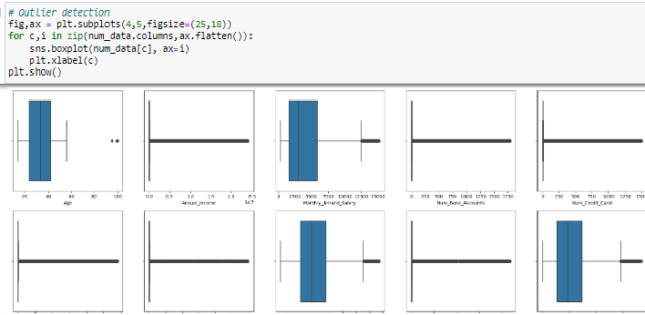
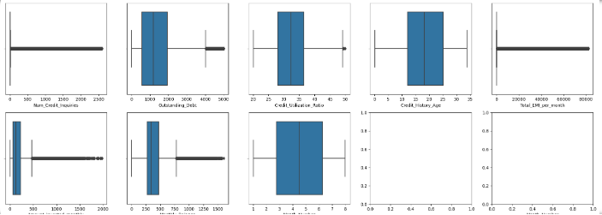

Slide 30
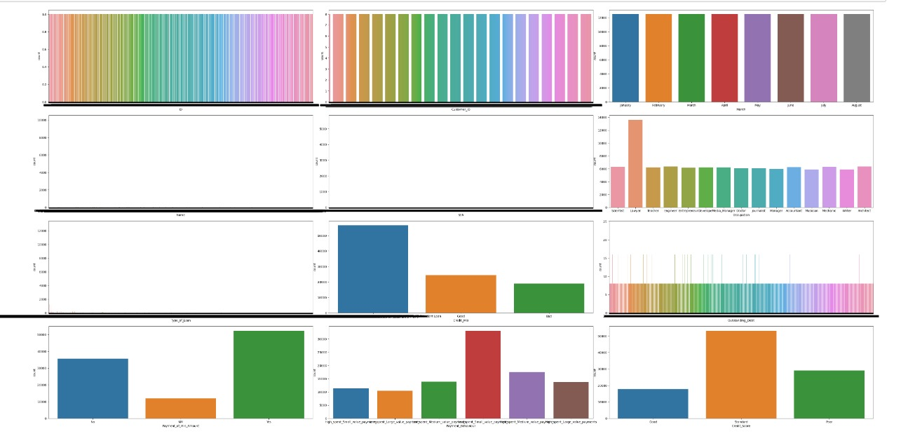
Univariate Analysis for categorical variable
In [ ]:
In [
1) In Payment_of_min_Amount 3 unique categories are observed yes is the domainating class followed by No then NM. This is the minimum amount of money that must be paid in order to avoid late payment fees or negative impacts on the borrower's credit score.
2) In 'Payment_Behaviour' 6 unique categories are notice amont them Low_spent_Small_value_payments is the Domainating class.
3) A score of 670 or higher is considered "Good" , A score between 580 and 669 is considered "Fair" or "Standard," , A score below 580 is considered "Poor" in our case standard credit score is domainating class followed by Poor credit_score
4) In "Credit_Mix" Standard is highest occurance followed by Good then bad.
5) In "Occupation" variable it is observe that Lawyer is the occupation where the maximum people are working

Slide 31
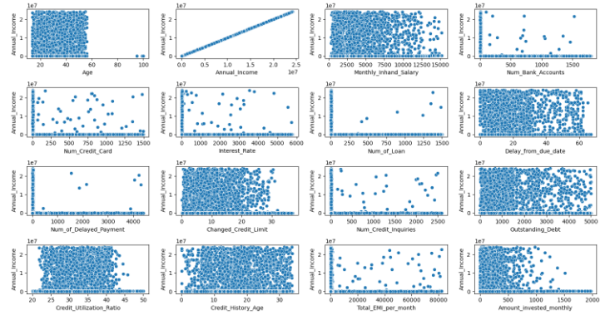
Bivariate analysis of Numeric Numerical vaiable
1) Their is relation between Annual_Income and Num_credit_Card, Annual_Income and interest_Rate , annual_Income and Amount_Invested_Monthly
2) Their is positive co-rrelation between Annual_Income vs Total_EMI_per_Month, Num_of_Loan, Num_of_Credit_card

Slide 32
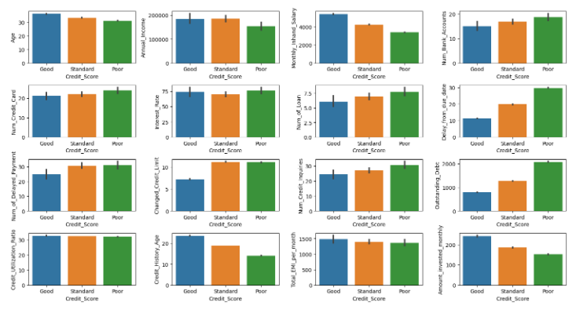
Bivariate analysis of Numeric Categorical vaiable
1) The People who have higher Annual_Income They have good credit_score, The People who have more No_of_Bank_Accouts Their credit_score is poor.
2) The People who have more credit_card they have Poor Credit_score, The people who delay the Credit_card payment they have Poor Credit_score.
3) The People who Amount_of_Invesment_monthly is hight as well as monthly_Balance is high their credit_Score is Good.

Slide 33
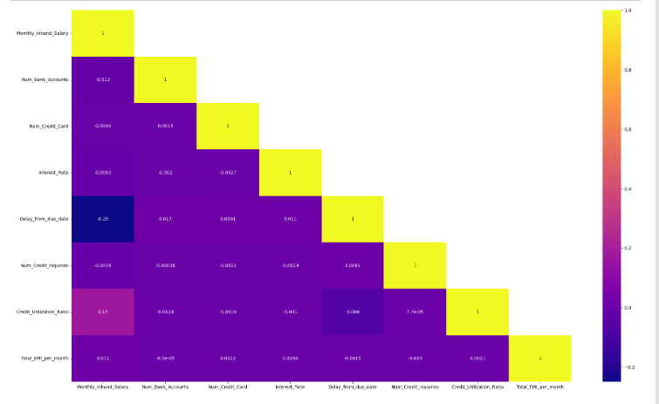
Multivariate analyses Numerical to Numerical¶

Slide 34
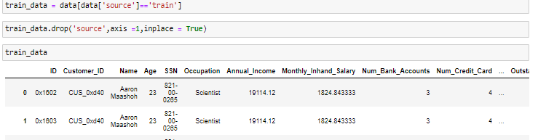
Step 9: Separate your Train dataset and test data set if you combined them in the initial steps. (In this step only segregate train and test datasets based on the length of the train and test dataset) Note: Your given test dataset is only for validating and submitting the results. Only Use the Train dataset to perform the train test split in the coming steps. Do not use Test to build the model and test the model, Since there is no target variable in the test data set you can not test the model performance with the test data set. Thus we only consider the training dataset and split that into X_train and X_test.

Slide 35

Step 11: Perform the Statistical analysis to prove where the independent variables have an effect on the Target variables. Example: Few statistical analyses:
Check whether the Annual income across all the target variables is significantly the same. Let's fix the alpha is 0.05. Make sure the data is normal and the variance is equal. If not use a Non-parametric statistical test.
Check if there is an independence of the Occupation and Credit Score. The significant level is 0.05.
Check if there is a relationship between the Payment Behaviour and Credit Score.
Check Statistically that the Credit_Utilization_Ratio median values significantly not different across the target variable classes.
From the above result, we can see that the p-value is less than 0.05 then reject null hypothesis, thus we can say that the data is not normally distributed. to check independency of variable we are using chi-square test for the independence

Slide 36
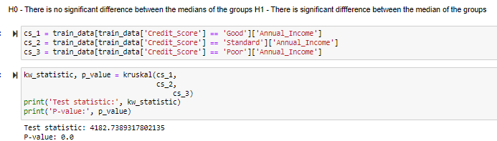
As P value is less then 0.05 we will regect null hypothesis hence we can conclude there is significant difference between the medians of the group.

Slide 37
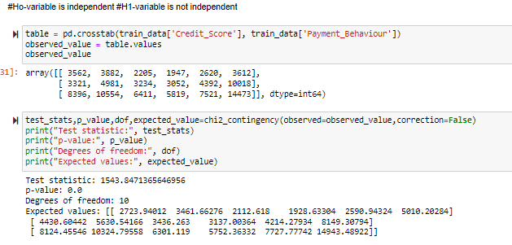
Check if there is a relationship between the Payment Behaviour and Credit Score
As the p_value is < then 0.05 , reject null which means the varibles 'Payment_Behaviour' and target varible are not independent

Slide 38
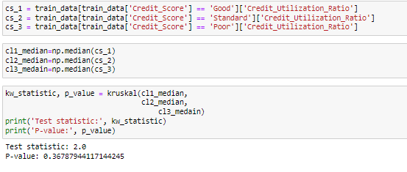
Check Statistically that the Credit_Utilization_Ratio median values are significantly not different across the target variable classes.
As the p value is greater then 0.05 fail to reject null hence we can say that Credit_Utilization_Ratio median values are significantly not different across the target variable classes.

Slide 39
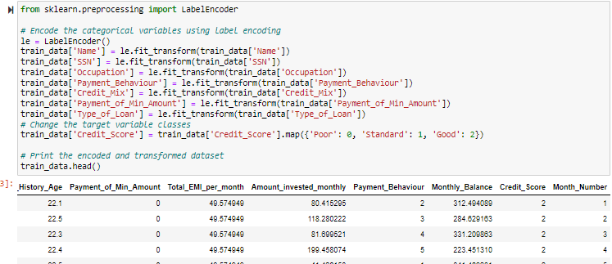
Step 12: Encode the categorical variables with related technologies. Change the target variable classes as (poor to 0, Standard to 1, Good to 2).

Slide 40
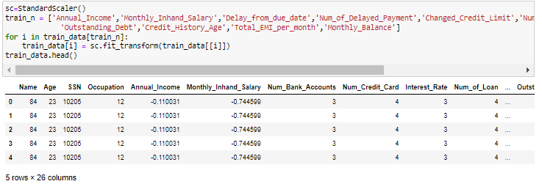
Step 13: Scale the numerical features

Slide 41
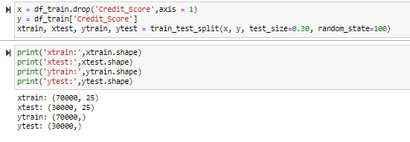
Step 14: Use a train test split on the dataset called a train.

Slide 42
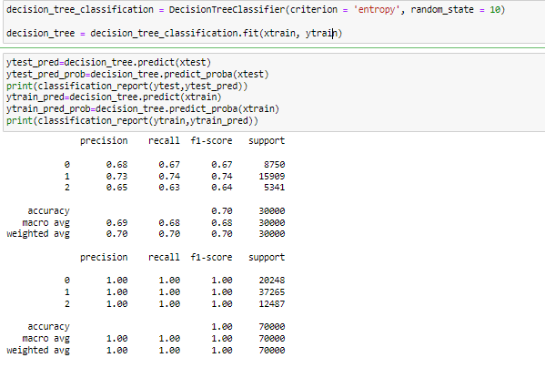
Step 15: Build the base model. Observe how the model is performing
The train data is getting overfit while test has accuracy 0.70

Slide 43
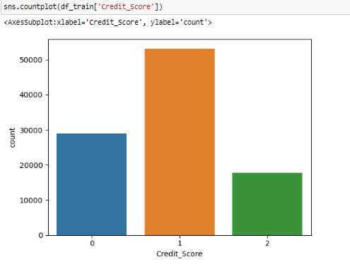
Checking imbalancing of data
Data is imbalance hence we need to do SMOTE analysis to balance the data

Slide 44
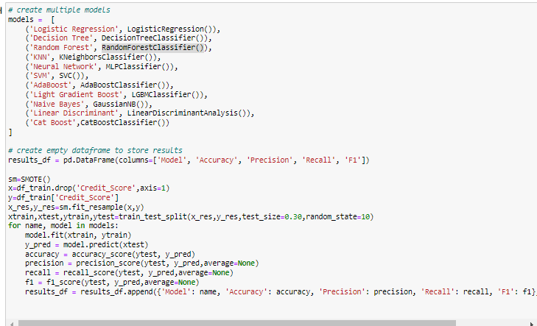
Step 16: Build other models and choose the model which gives the best results

Slide 45
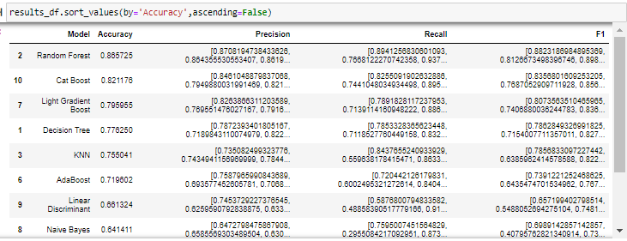
Results
After building several model and comparing it accuracy,precision and recall we can conclude that Random Forest is giving highest accuracy

Slide 46
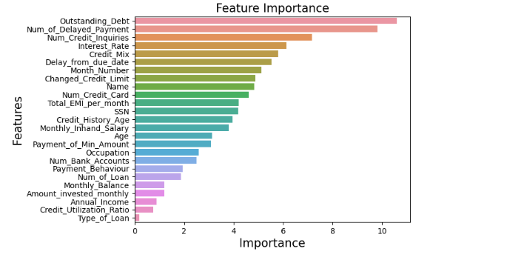
Step 17: Perform Feature selection using different feature selection methodods.
'Outstanding_Debt','Num_of_Delayed_Payment','Num_Credit_Inquiries','Interest_Rate','Credit_Mix' 'Delay_from_due_date','Month_Number','Changed_Credit_Limit','Name','Num_Credit_Card' are consider as important features ,then we have builded a model this best features

Slide 47
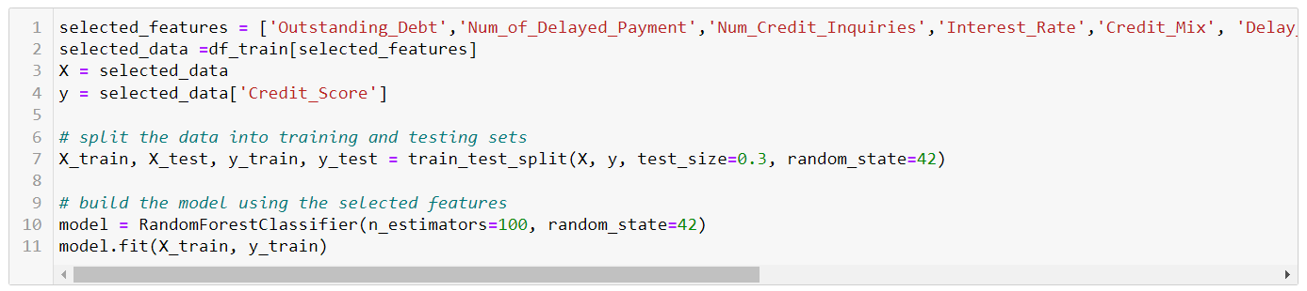
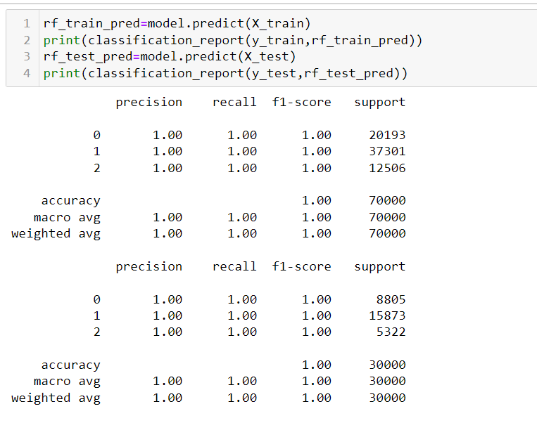
Build model on best parameters

Slide 48
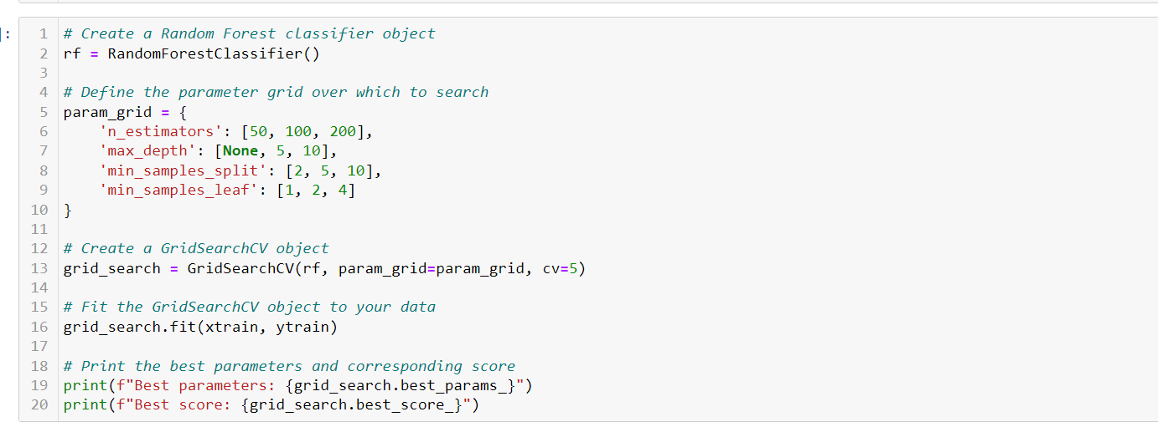
Step 18: Tune the final model using Grid search CV or Randomized CV or any other methods.
This are the best parameters obtain by GridSrach Cv Now build model using this best parameters

Slide 49
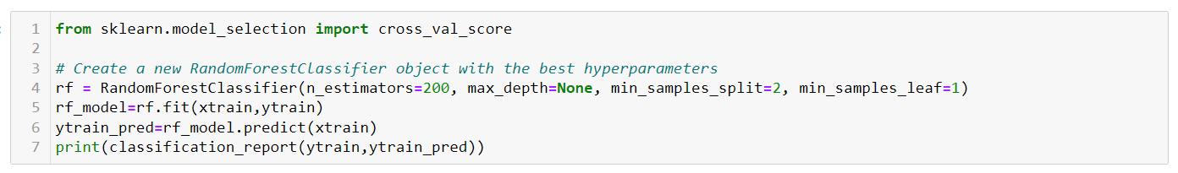
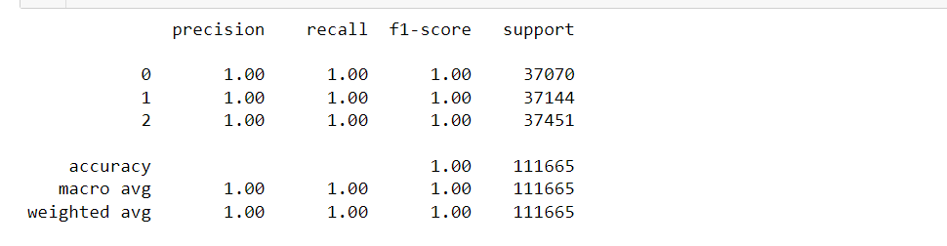
Step 20: Perform Cross-validation for the final model by setting the best parameters

Slide 50
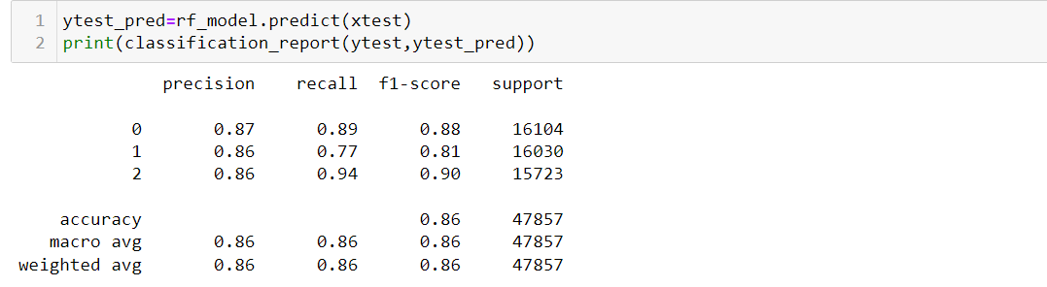
Inference – the model is giving accuracy for train data is 1.0 which is highly overfit while test having accuracy 0.86 hence we can say that the train model is getting overfit with respect to test data.

Slide 51
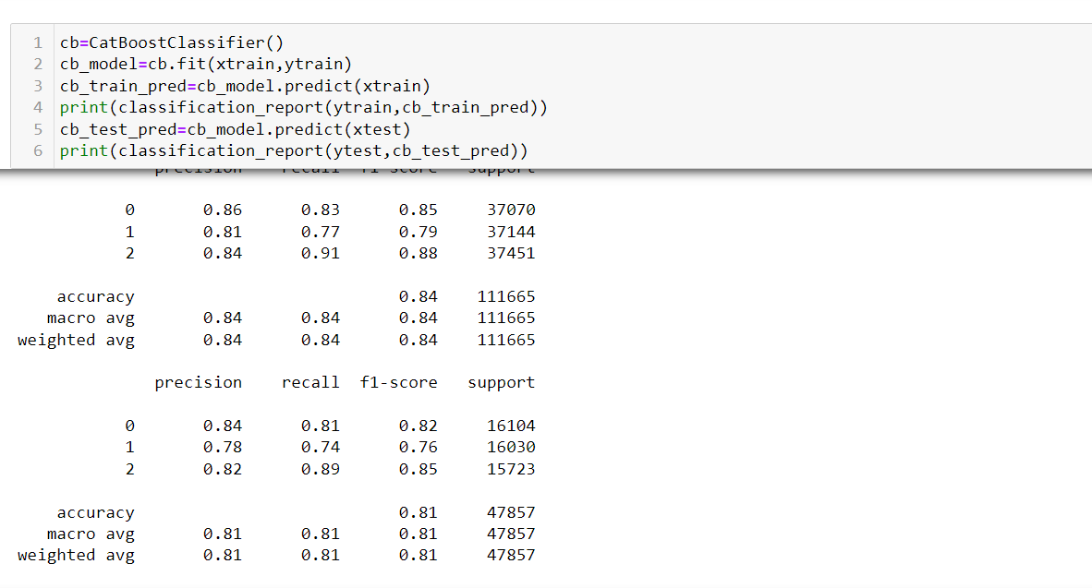
Building catBoost model
Inference – Cataboost model giving accuracy for train set 0.84 and for test set it is 0.81 which means catboost model is performing quit good comparing to Random Forest

Slide 52
Tune the final model using Grid search CV any other methods.
The best parameters across All searched params:/n {'depth': 9, 'iterations': 500, 'learning_rate': 0.1}

Slide 53
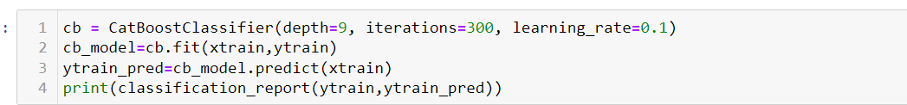
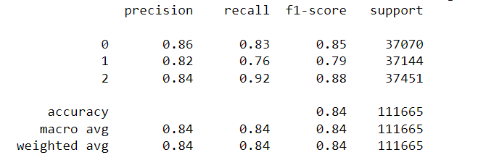
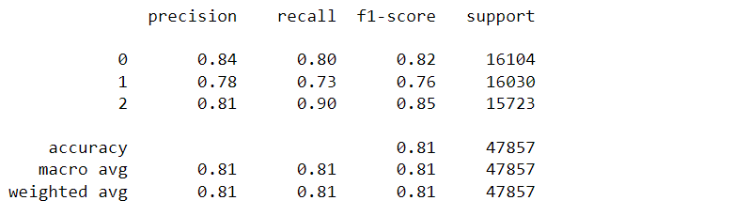
Build the model using Best parameters
Inference – After using Best Parameters the model is giving accuracy 0.84 for train data and and 0.81 for test data . Hence we can say that the model is performing quit good compare to Random Forest

Slide 54
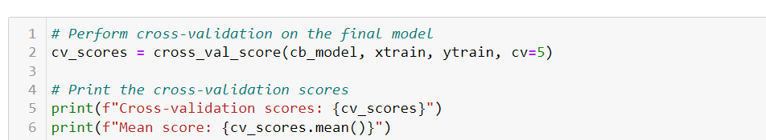
Perform Cross validation on Catboost Model
Inference - As the cross-validation score and the mean score are both 0.80, it means that the model consistent in its performance and is able to generalize well to new data. In some cases, an accuracy of 80% can be considered excellent.

Slide 55
Business Insight
We saw that the accuracy of the Random Forest model is 0.86. After selecting important features and applying the gradient boosting classifier the accuracy of the model was still same that is 0.86 for test data and 1.0 for train data it could indicate that the model is overfitting the training data.
Then we have builded Cat Boost model with accuracy 0.84 for train data and 0.81 for test which was same even after applying best parameters.
After applying the k fold cross validation for 10 folds the accuracy which we got was 0.80.
It means that the model is able to correctly classify 80% of the samples in the dataset. which indicates that the model is performing fairly well in terms of generalization
That means it can predict well on new and unseen data.

Slide 56


